Slide 1
P 183 – TEAM 3 REAL ESTATE - DATA ANALYSIS
Team Members:
Mr. Gaurav R Thakare
Ms. Vaishnavi Kinarkar
Mr. Shivaprasad P Goni
Ms. Shama Patil
Mentors:
Mr. Rajashekar Madishetti
Ms. Pallavi Bapuram

Slide 2

Contents
Abstract
Introduction
Project Process
1
2
3
Model Building
Deployment
Conclusion
4
5
6

Slide 3
1. Abstract
Real Estate is least transparent industry in our ecosystem.
Property prices increases every year, so there is a need for a system to predict property prices in future.
Predicting property prices with real factors.
Buying a home, especially in a city like Bengaluru is a tricky choice. By analyzing the dataset, we will be able to understand how house prices are affected by various factors, and then apply machine learning regression to establish an approximate price for properties.

Slide 4
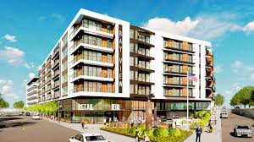
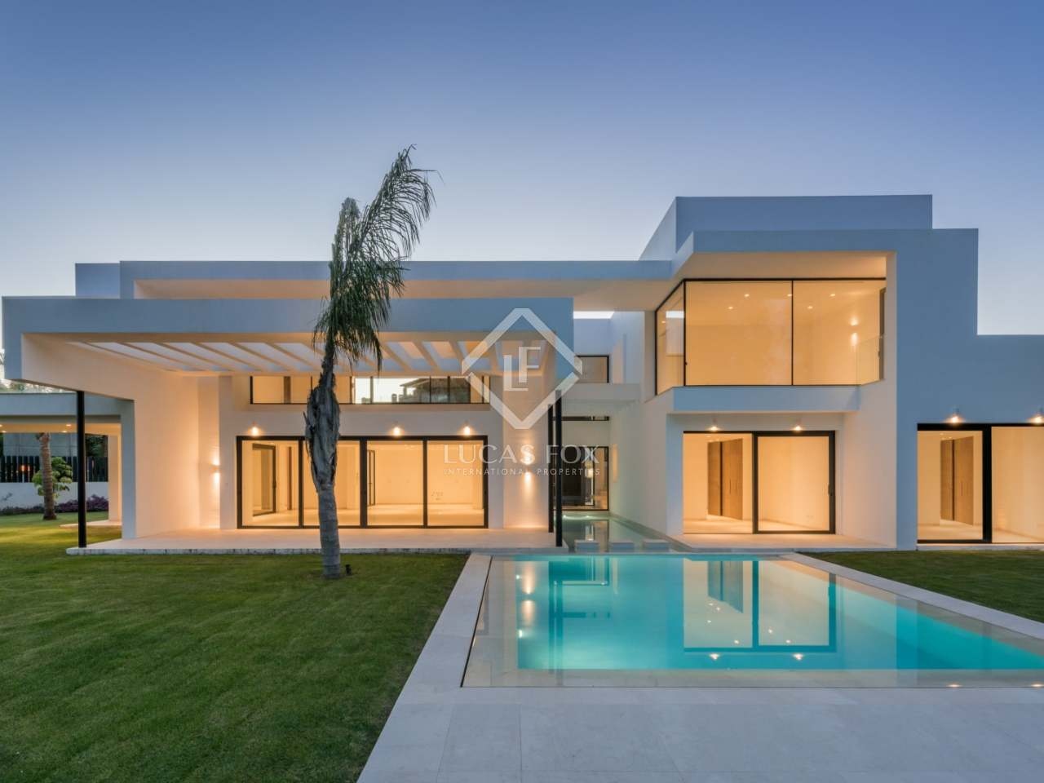
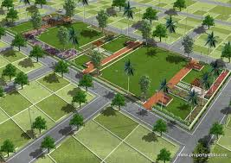
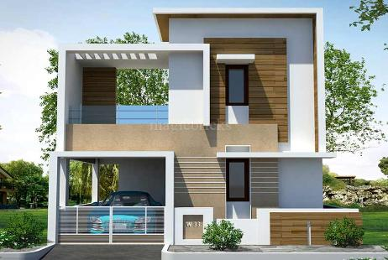
2. Introduction
The project “Real Estate – Data Analysis”, provides various insights on different kinds of properties in Bangalore city based on certain attributes.
This Project reduces efforts, saves time in searching and choosing the property that suits one’s needs and requirements.
It deals with analysing the data by creating different models to estimate forecast revenue, predicting the sale value of different houses and plots. In this project, we have built a machine learning model to predict house prices of Bengaluru. Random Forest algorithm is used to create model with great accuracy score.

Slide 5
3. Project Process
Data understanding
Data Extraction
Data Cleaning &Data Visualization
Creating different models
Deployment
1
2
5
3
4

Slide 6
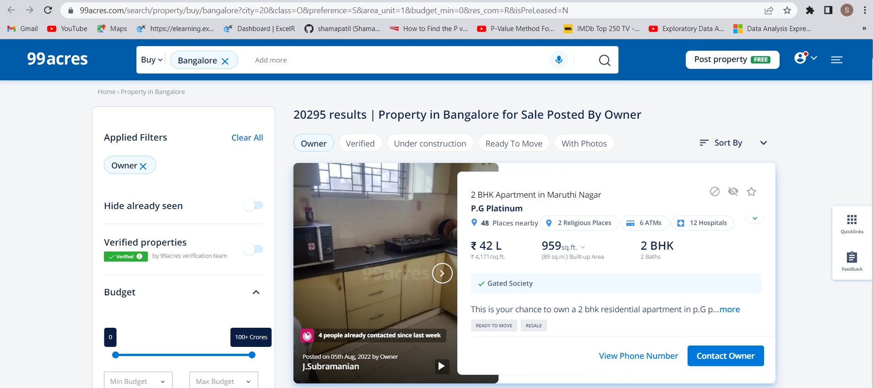
Data understanding
Website :
“https://www.99acres.com/search/property/buy/bangalore?city=20&class=O&preference=S&area_unit=1&budget_min=0&res_com=R&isPreLeased=N”
The features in the dataset are Title, Location, Bedrooms, Bathrooms, Total_sqft, Price_per_sqft, Price(Lakhs), Area_Type.
Title
Location
Bedrooms
Bathrooms
Total_sqft
Price_per_sqft
Price(Lakhs)
Area_Type

Slide 7
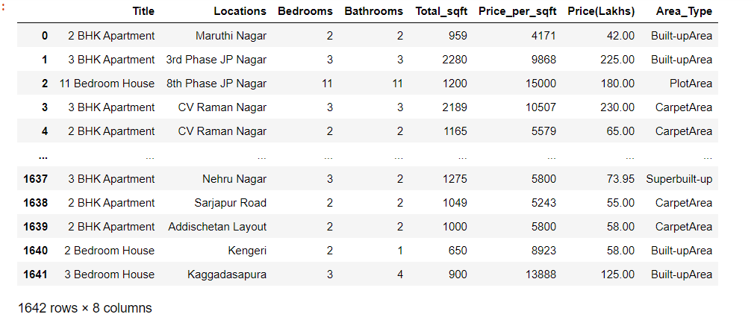
Data Extraction Selenium: from selenium import webdriver
Dataset :

Slide 8
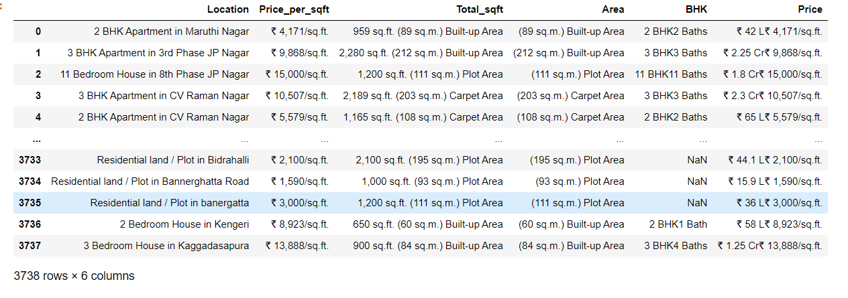
Data Cleaning
Before Cleaning :
(3738, 6)
(1642, 8)
After Cleaning :

Slide 9
3. Data Visualization(EDA)
Exploratory Data Analysis (EDA) is an approach for data analysis that employs a variety of techniques (mostly graphical) to :
maximize insight into a data set
uncover underlying structure
Get to know new assumptions
EDA can be performed by :
Univariate Analysis
Bivariate Analysis
Multivariate Analysis
Libraries :
import matplotlib.pyplot as plt
import seaborn as sns

Slide 10
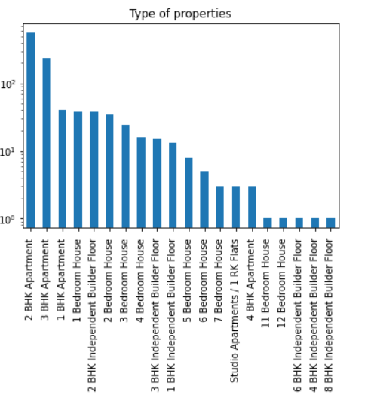
3.1 Univariate Analysis
Univariate analysis is the simplest form of analysing data. “Uni” means “one”, so in other words your data has only one variable. It doesn't deal with relationships and it's major purpose is to describe; it takes data, summarizes that data and finds patterns in the data.
Types of plots used for Univariate Analysis:
Histograms
Pie charts
Bar graphs
Density plots
For Example :
Bar Graph for types of properties

Slide 11
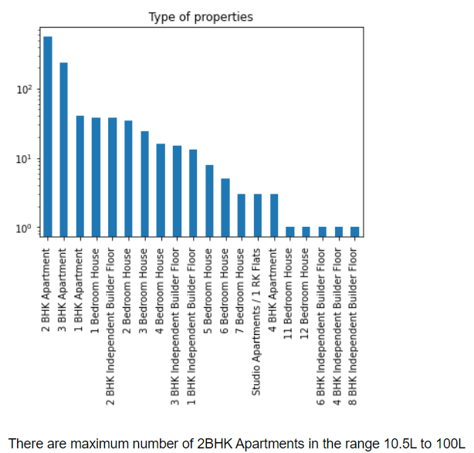
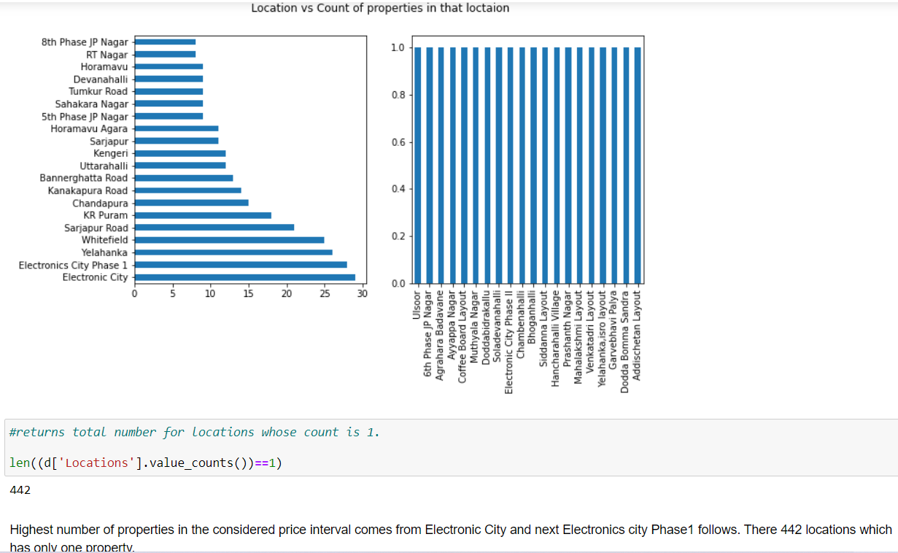
The minimum and maximum price for the property in the dataset are 10.5L and 864L. As there are more number of observations in the dataset, we have divided the price attribute into two intervals i.e., (10.5L – 100L) and (100L – 900L)
First Interval :
Types of properties Location vs Count of properties in that location
Highest number of properties in the considered price interval comes from Electronic City and next Electronics city Phase1 follows. There 442 locations which has only one property.
There are maximum number of 2BHK Apartments in the range 10.5L to 100L

Slide 12
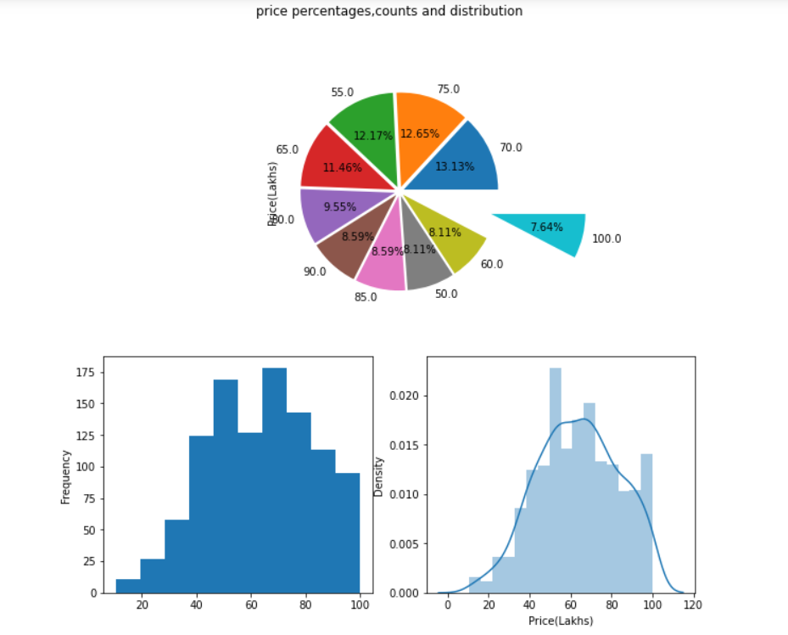
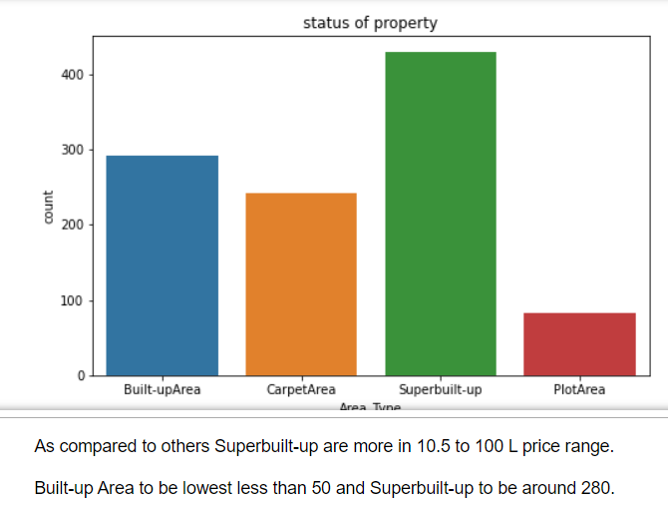
Price percentage, counts and distribution
Count of Area_Type
Approximately 13.13% of properties in the price range 10.5L to 80 L have price as 70 L. 12.65% of properties have price as 75 L. 7.64% of properties have price as 100 L.
As compared to others Superbuilt-up are more in 10.5 to 100 L price range.
Built-up Area to be lowest less than 50 and Superbuilt-up to be around 280.

Slide 13
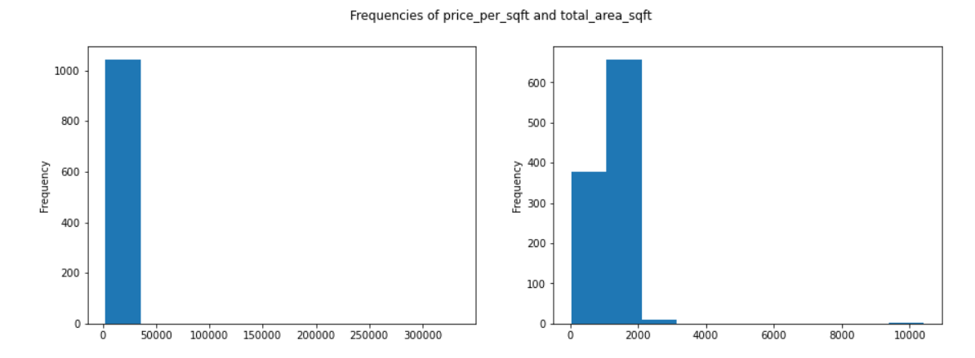
Price_per_sqft & Total_Area_sqft
From the above histogram for price_per_sqft and total_sqft, properties in 10.5L to 80L range have price_per_sqft price between 100 to 1000.

Slide 14
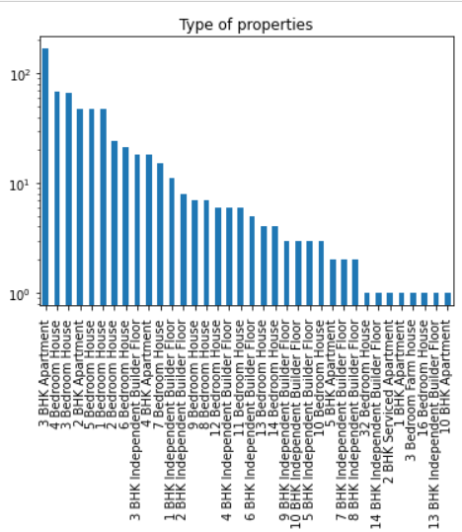
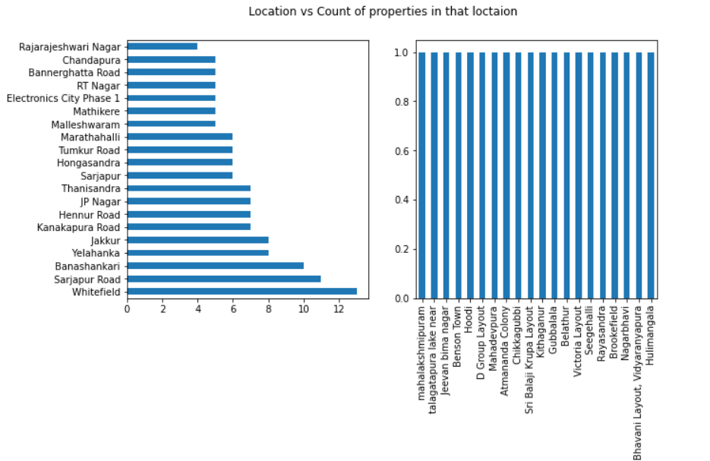
2nd Interval :
Types of properties Location vs Count of properties in that location
Highest number of properties in the considered price interval comes from Whitefield and followed by sarjapura road and follows.
There are almost 150 3BHK Apartment, 120 2BHK Apartment, 50 3BHK houses, 50 4BHK house and follows.

Slide 15
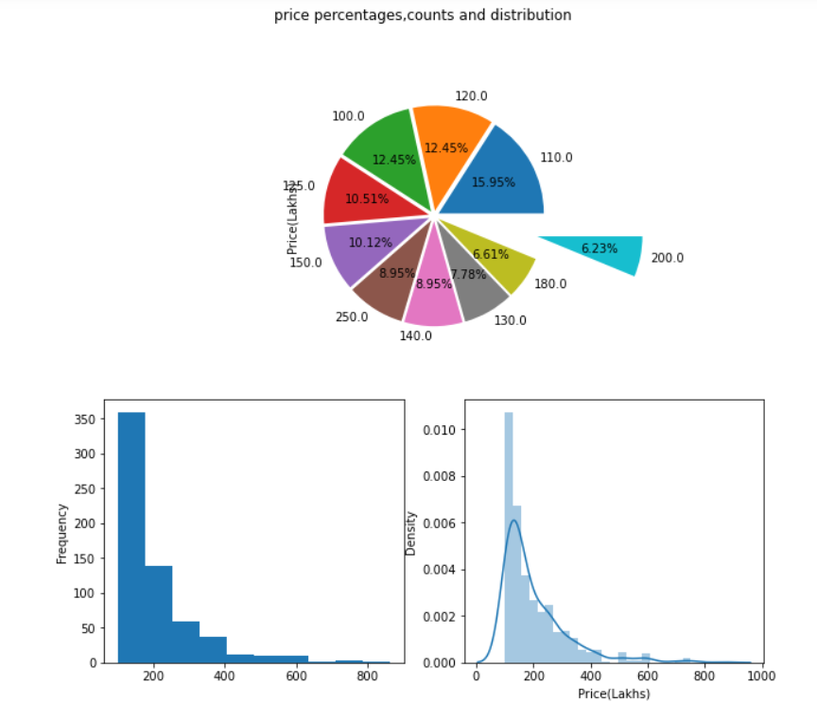
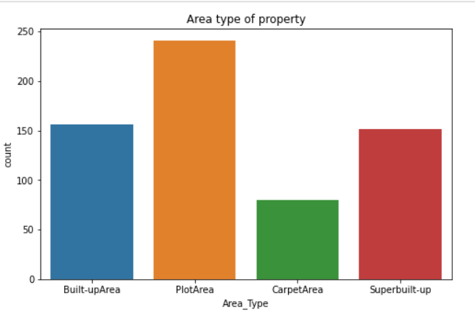
Price percentage, counts and distribution
Count of Area_Type
Superbuilt-up are more in 80 to 160 L price range.
CarpetArea to be lowest less than 100 and Superbuilt-up to be highest.
Approximately 12.73% of properties in the price range 80 to 160 L have price as 110 L.
12.42% of properties have price as 80 L.
8.07% of properties have price as 150 L.

Slide 16
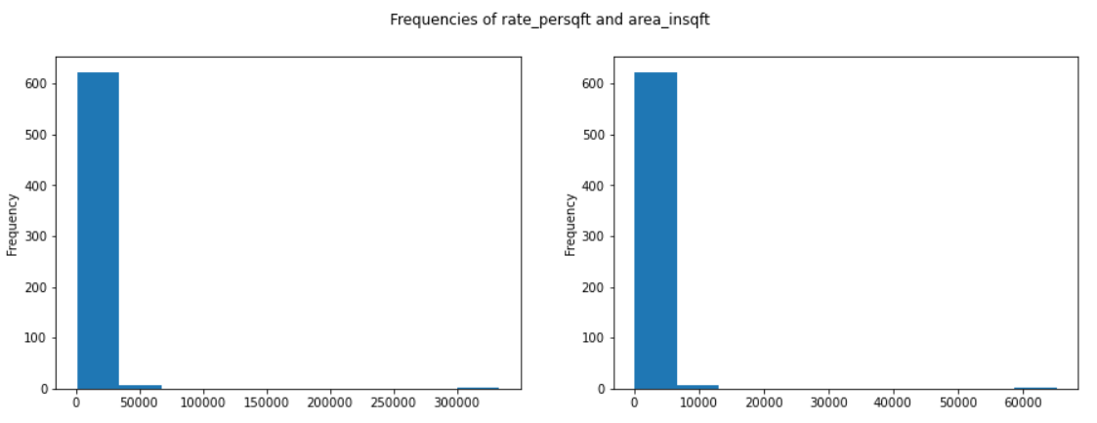
Price_per_sqft & Total_Area_sqft
From the above histogram, 700 properties in 80 to 160L range have rate_per_sqft price between 100 to 30000.
Area of properties are mostly around 100 to 6000 i.e, almost 700 properties

Slide 17
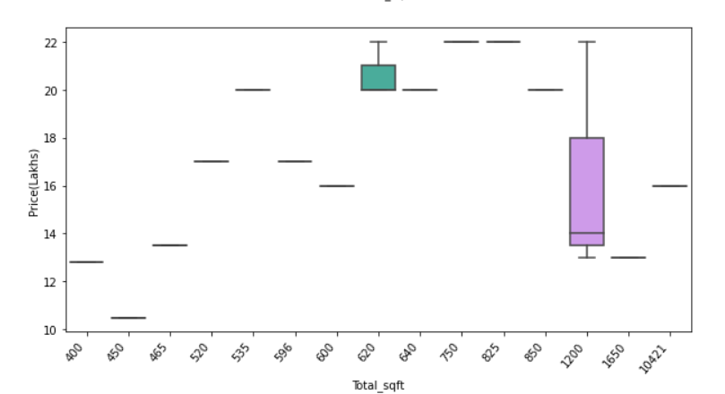
3.2 Bivariate Analysis
Bivariate analysis is the simultaneous analysis of two variables (attributes). It explores the concept of relationship between two variables, whether there exists an association and the strength of this association
Types of plots used for Bivariate Analysis:
Box plot
Violin plot
Joint plot
Scatter plot
For Example :
Box plot b/w price and total area(sqft) of properties

Slide 18
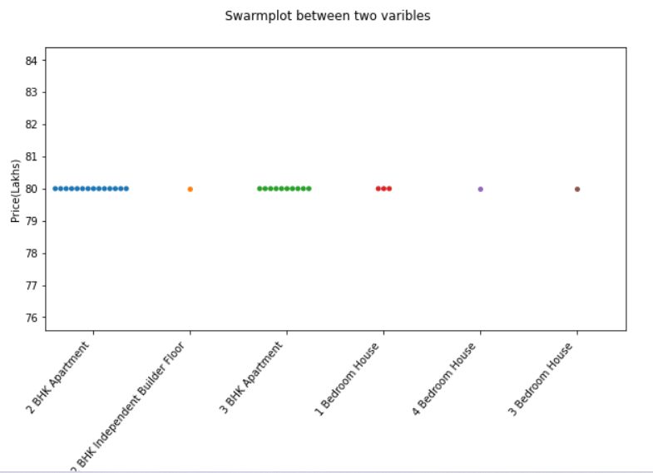
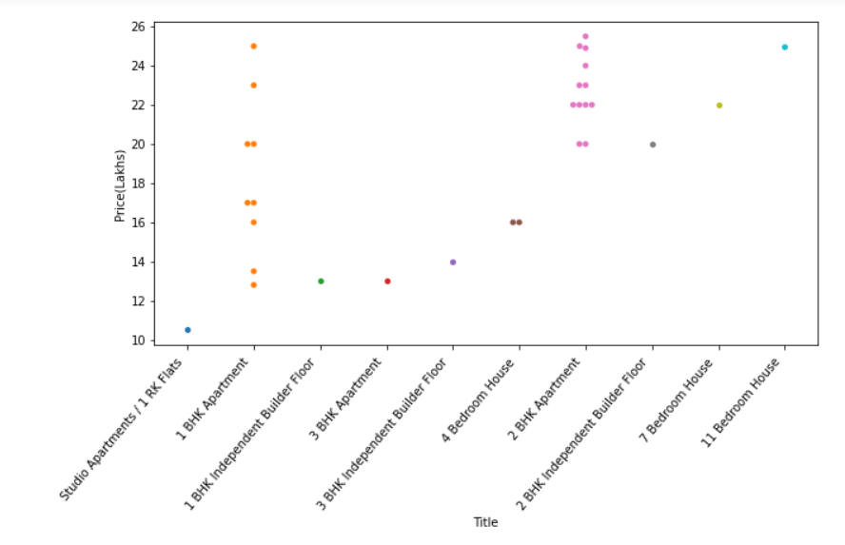
Swarmplot between Title vs Price(Lakhs)
Graph 1 :
For the price range of 10.5L to 80L from high to low price for top 30
Mostly, highest price is for 2BHK Apartment.
Graph 2:
For the price range of 10.5L to 80L from low to high price for bottom 30
Mostly, lowest price is for 1 BHK Apartment

Slide 19
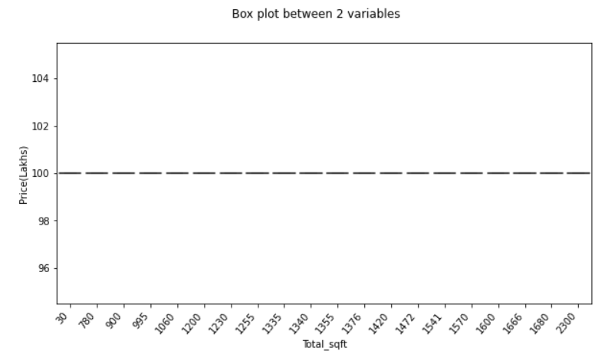
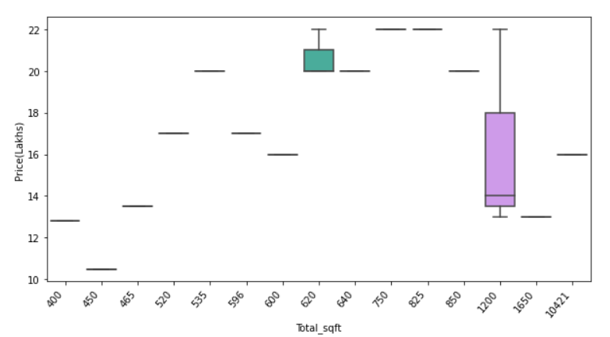
Box plot between Total_sqft Vs Price(Lakhs)
Graph 1 :
For the price range of 10.5L to 80L from high to low price for top 30
Mostly, same price for each kind of area per sqft.
Graph 2 :
For the price range of 10.5L to 80L from low to high price for bottom 30
Mostly, lowest price is for 450 sqfts.

Slide 20
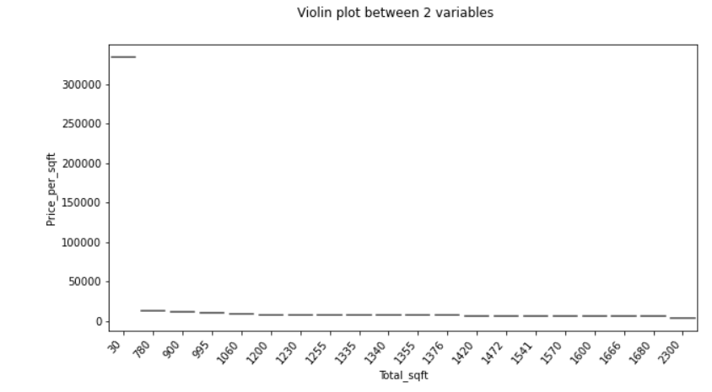
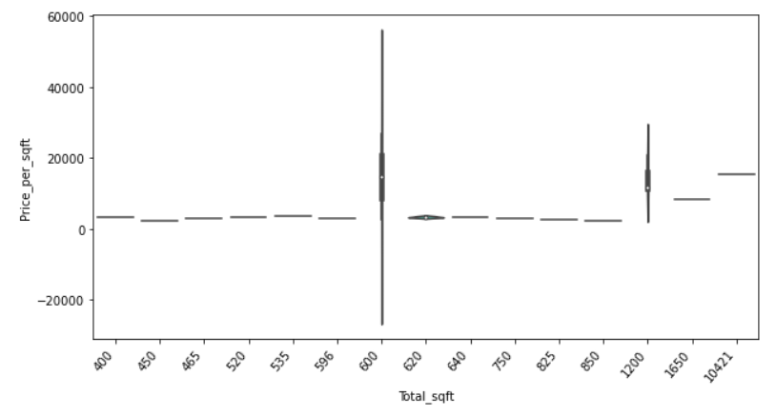
Violin plot between Total_sqft Vs Price_per_sqft
Graph 1 :
For the price range of 10.5L to 80L from high to low price for top 30
Graph 2 :
For the price range of 10.5L to 80L from low to high price for bottom 30
Mostly, minimum area in sqft is for 3000 rate per sqft

Slide 21
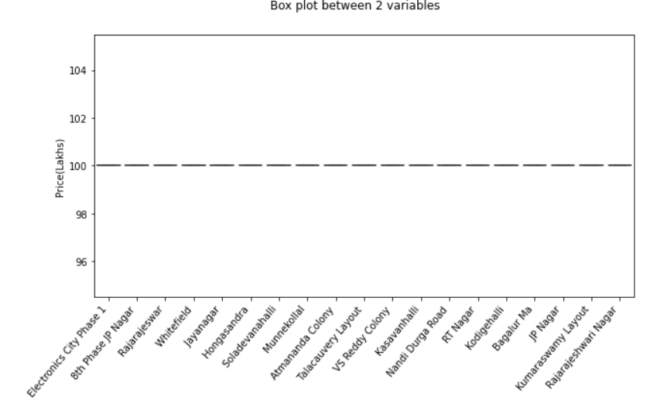
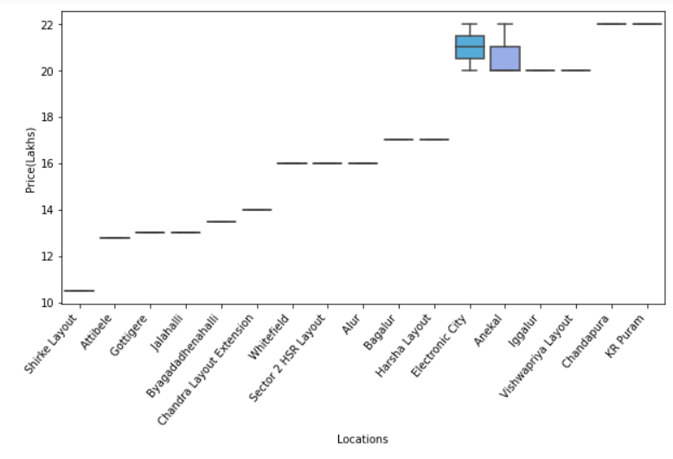
Box plot between Location Vs Price(Lakhs)
Graph 1 :
For the price range of 10.5L to 80L from high to low price for top 30
Mostly, same price for each kind of location
Graph 2 :
For the price range of 10.5L to 80L from low to high price for bottom 30
Mostly, lowest price around 10L for shirke Layout.

Slide 22
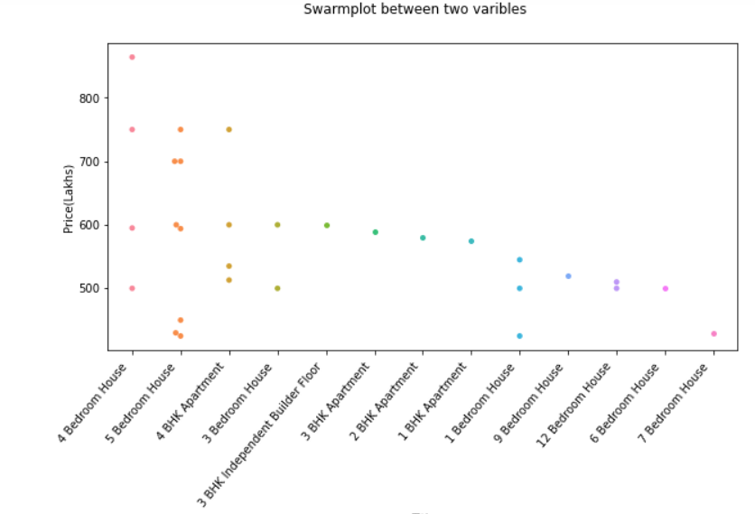
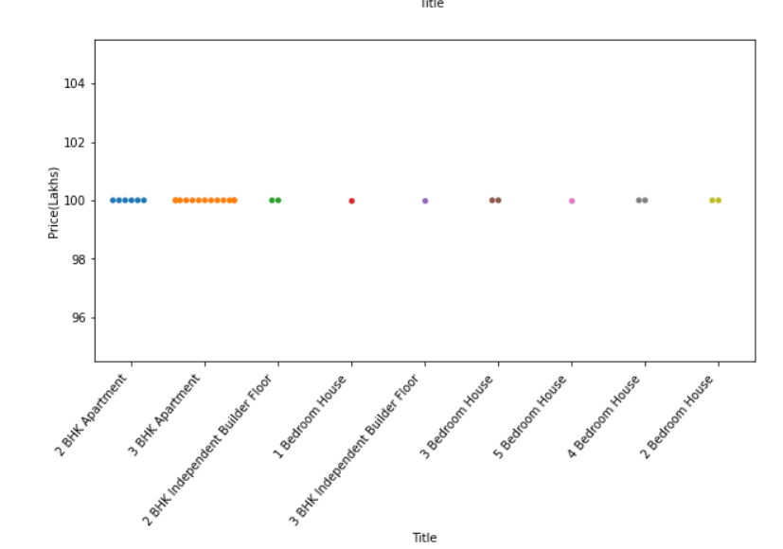
2nd Interval :
Swarmplot between Title vs Price(Lakhs)
Graph 1 :
For the price range of 100L to 800L from high to low price for top 30
Mostly, highest price of more than 800L is there for 4 Bedroom house, followed by 5 Bedroom house and 4BHK Apartment
Graph 2 :
For the price range of 100L to 800L from low to high price for bottom 30
In this,3BHK Apartment are more in number for the minimum price approximately.

Slide 23
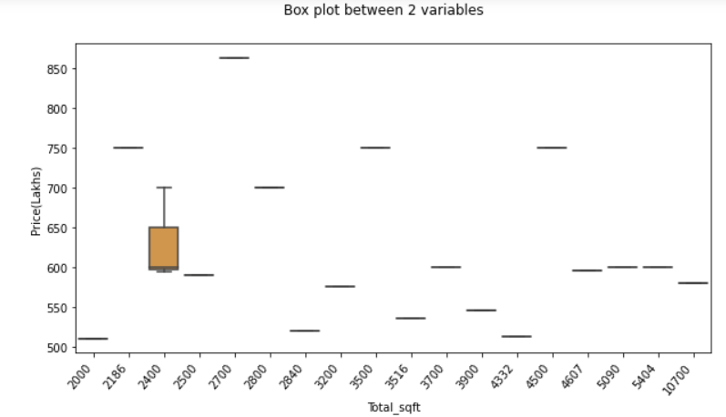
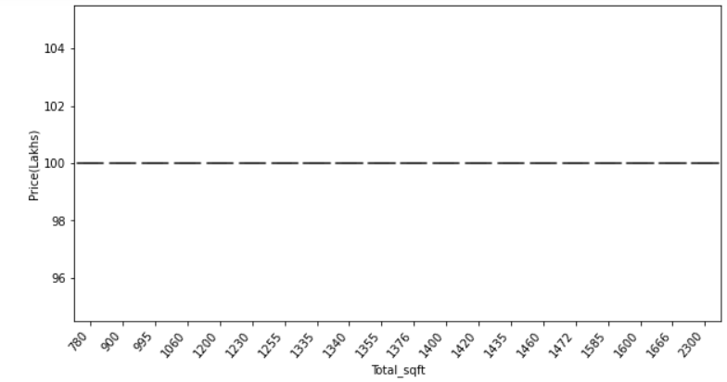
Box plot between Total_sqft Vs Price(Lakhs)
Graph 1 :
For the price range of 100L to 900L from high to low price for top 30
Mostly, highest price of 860L is there for 2700 sqft in this plot
Graph 2 :
For the price range of 100L to 900L from low to high price for bottom 30
Mostly, lowest price of 100L is there for all areas in sqft in this plot

Slide 24
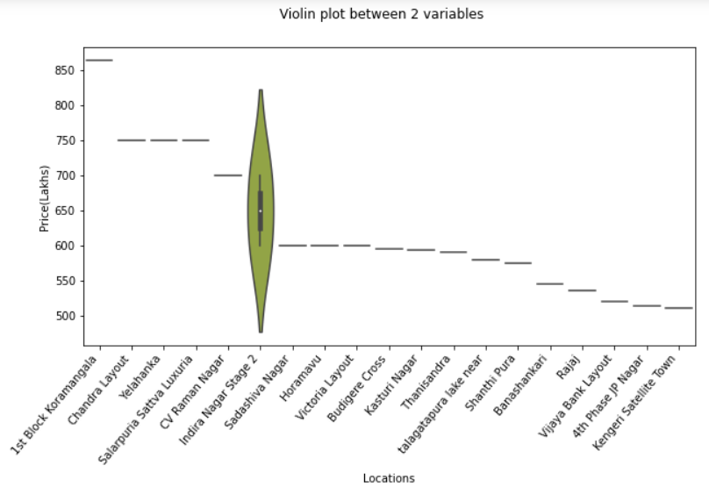
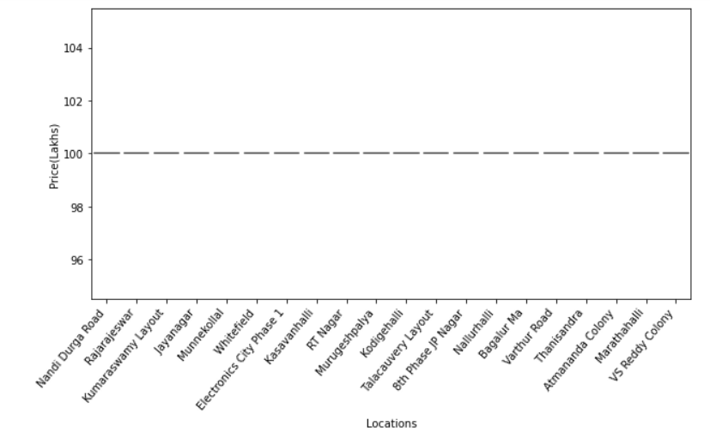
Violin plot between Total_sqft Vs Price_per_sqft
Graph 1 :
For the price range of 100L to 900L from high to low price for top 30
Mostly, highest price of 860L is there in 1st Block Koramangala
Graph 2 :
For the price range of 100L to 700L from low to high price for bottom 30
Mostly, lowest price of 100L is there for all kinds of properties.

Slide 25
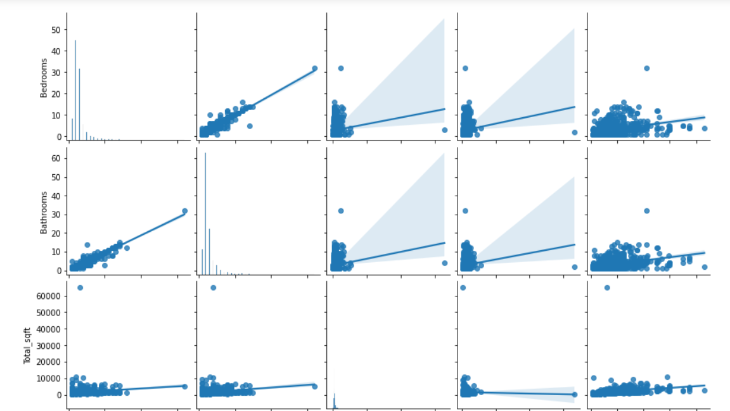
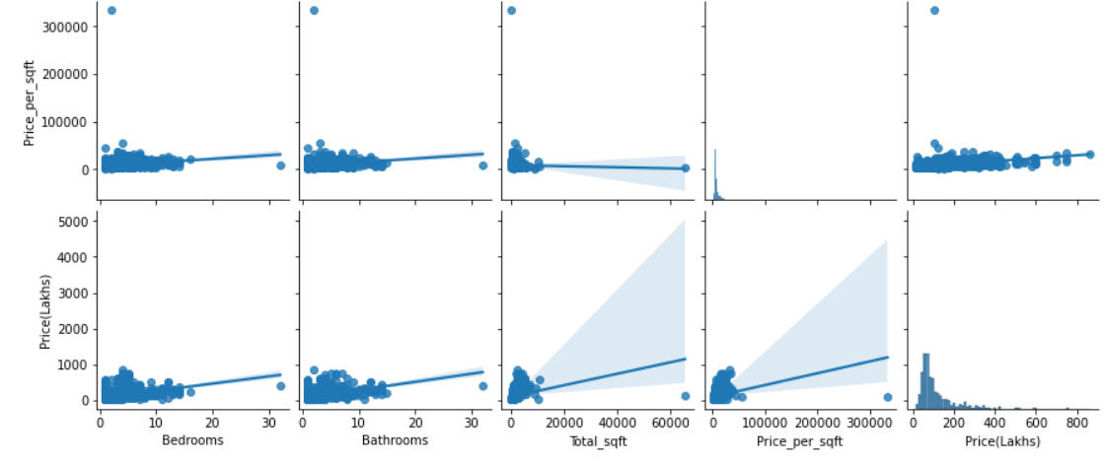
3.3 Multivariate Analysis
Multivariate analysis is performed to understand interactions between different fields in the dataset (or) finding interactions between variables more than.
Types of plots used for Multivariate Analysis
Pair plot
Heat maps
3D scatter plots
For Example :
pair plot btw different attributes

Slide 26
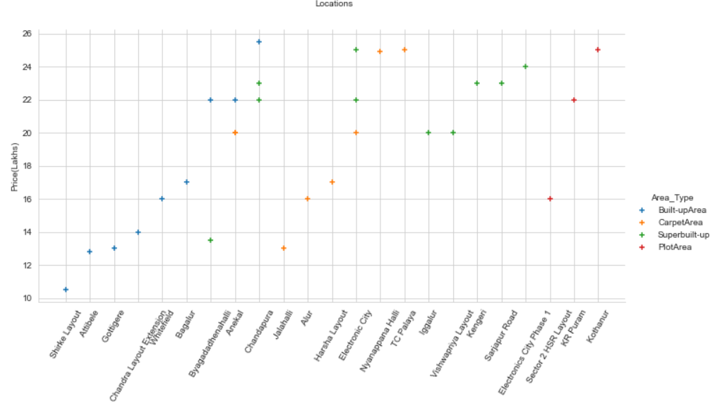
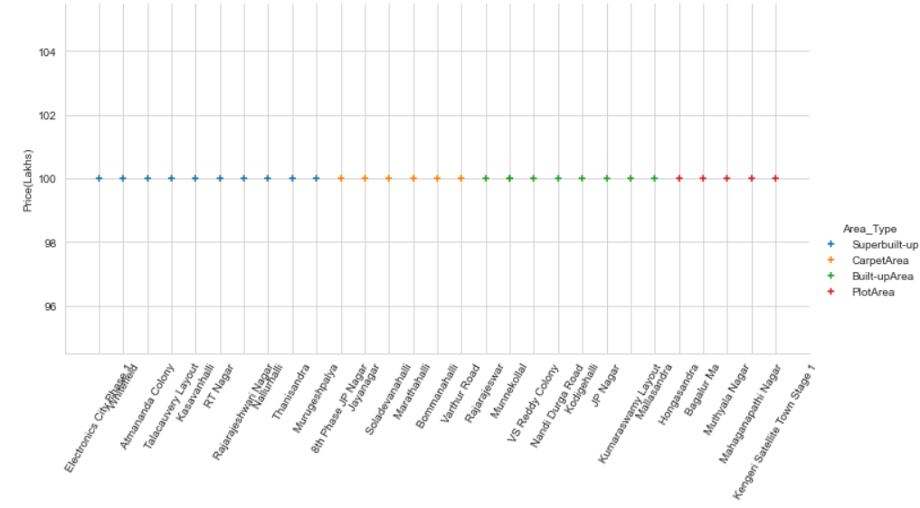
Multi scatter plot for Price vs Locations
Graph 1:
For the price range of 10.5L to 100L from high to low price for top 30
Mostly, highest price of 10L is there in all locations but Builtup Area are more from Electronic city phase 1 to Thanisandra.
Graph 2 :
For the price range of 10.5L to 100L from high to low price for bottom 30
Moslty, lowest price of around 10L is there for Built-up Area at Shirke Layout and highest price of 26L in chandrapura.

Slide 27
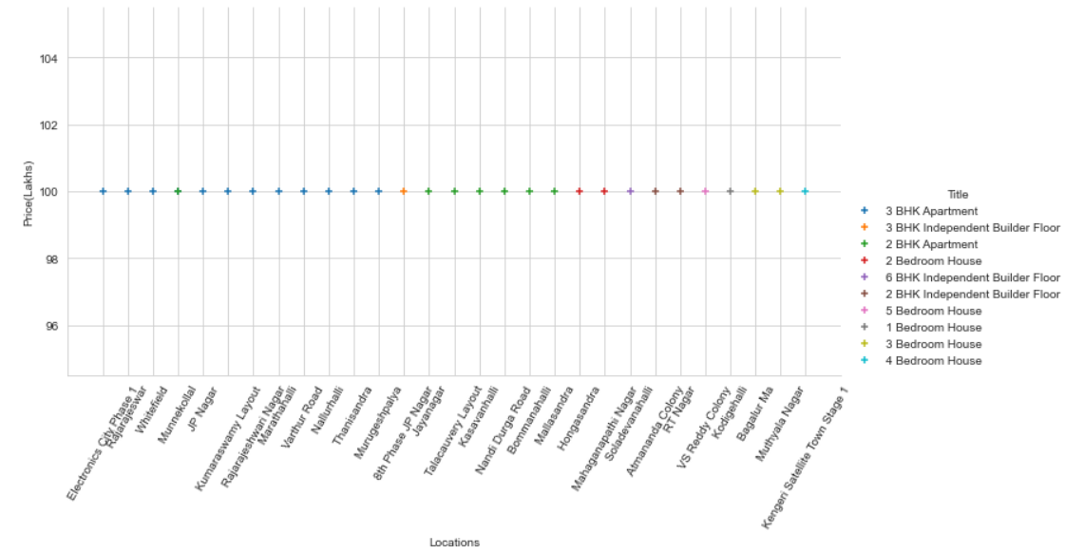
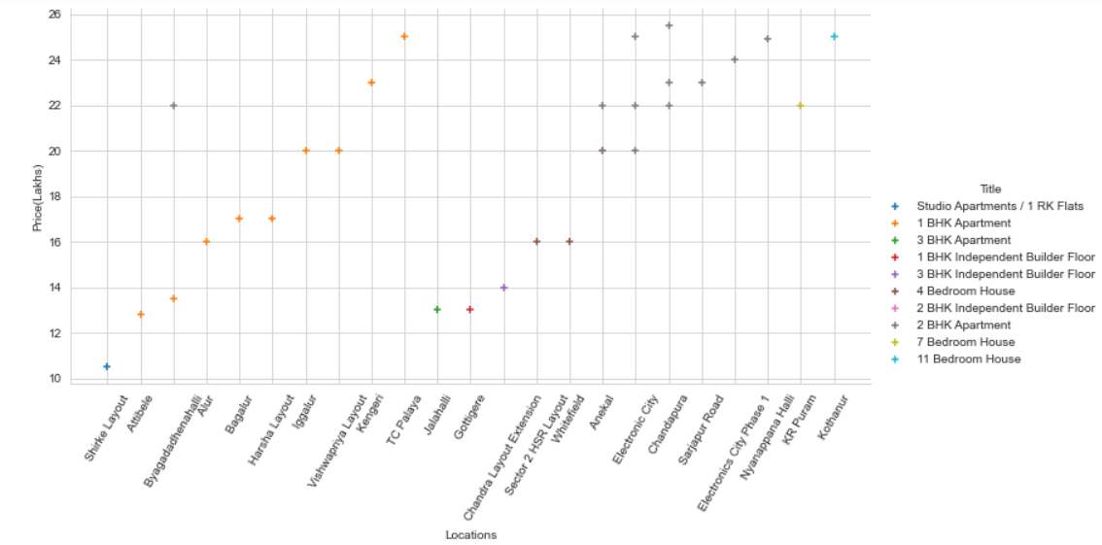
Multi scatter plot for Price vs Locations vs Title
Graph 1:
For the price range of 10.5L to 100L from high to low price for top 30
Mostly highest price of 1 Cr is there in all locations
From Electronic city phase 1 to Thanisandra there are more no. of 3BHK Apartment
Graph 2 :
For the price range of 10.5L to 100L from high to low price for bottom 30
Moslty, lowest price of 26L is there for 2BHK Apartment in Chandrapura, TC Palaya.

Slide 28
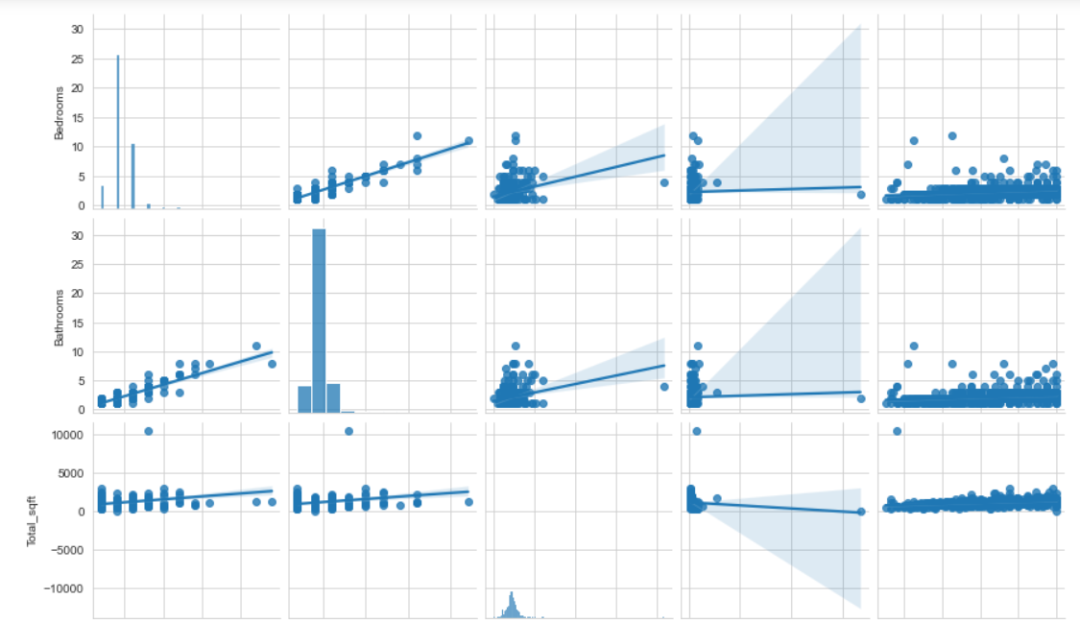
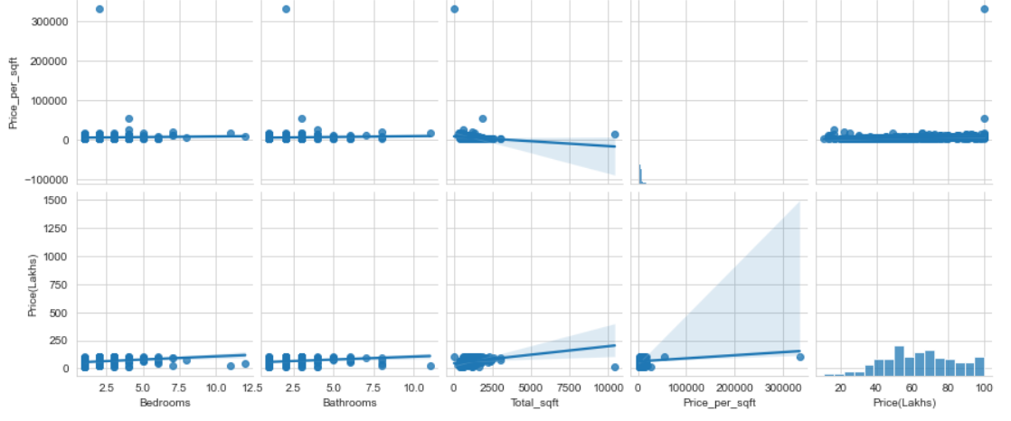
Pair plot between different attributes
For the price range of 10.5 to 100 L, the relationship between each and every variable is plotted where the plots below the diagonal are having mirror plots above the diagonal.
There are positive and negative slopes above and below of the diagonal.

Slide 29
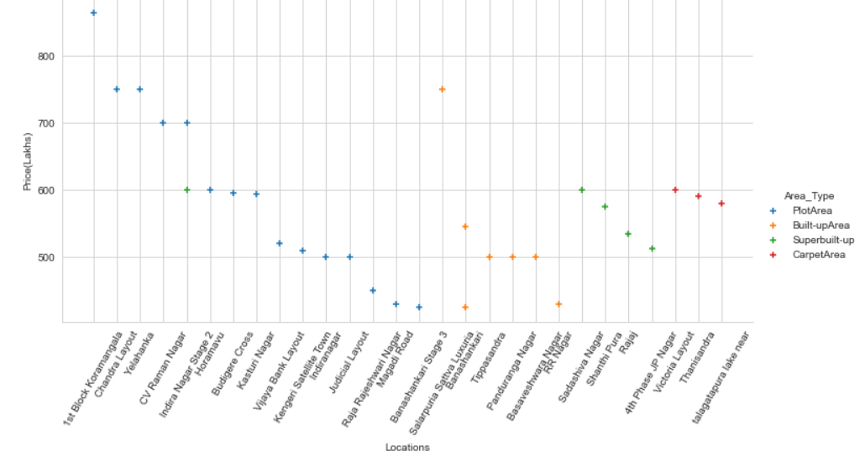
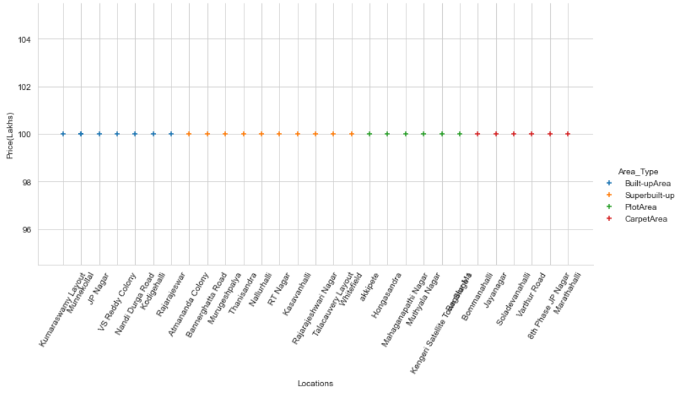
Multi scatter plot for Price vs Locations
Graph 1 :
For the price range of 100L to 900L from high to low price for top 30
Most of properties are of Plot Area type from 1st block koramangala to Magadi road.
Graph 2 :
For the price range of 100L to 900L from high to low price for bottom 30
Moslty, lowest price of 100L is there for Superbuilt-up area from Rajarajeshwar to Whitefield.

Slide 30
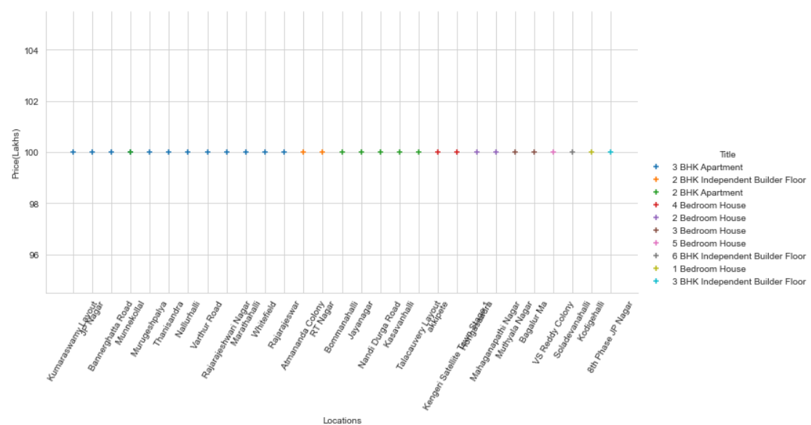
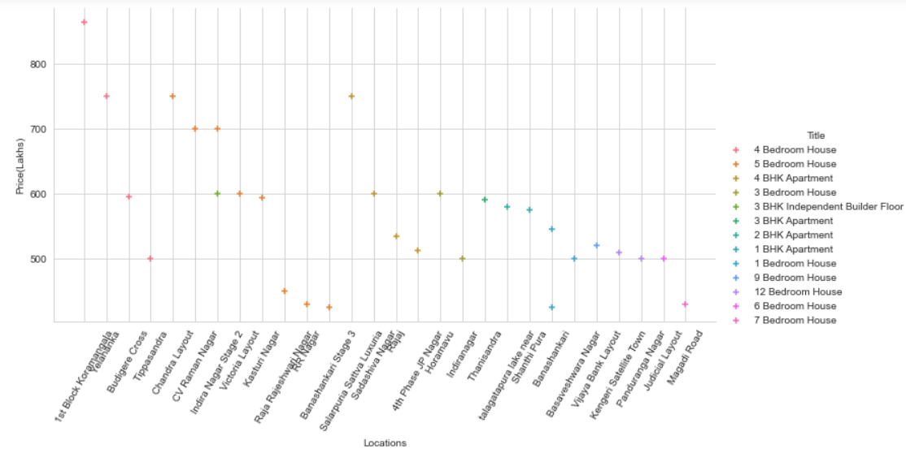
Multi scatter plot for Price vs Locations and Title
Graph 1 :
For the price range of 100 to 900L from high to low price for top 30
Mostly, highest price of 890L in 1st block koramangala
Graph 2 :
For the price range of 100 to 900L from high to low price for bottom 30
Moslty, lowest price of 100L and there are more 3BHK Apartment from Kumaraswamy Layout to Whitefield.

Slide 31
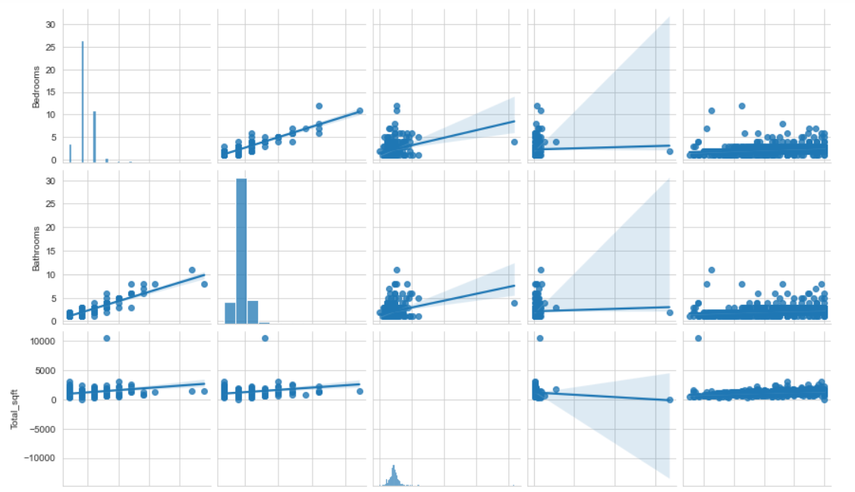
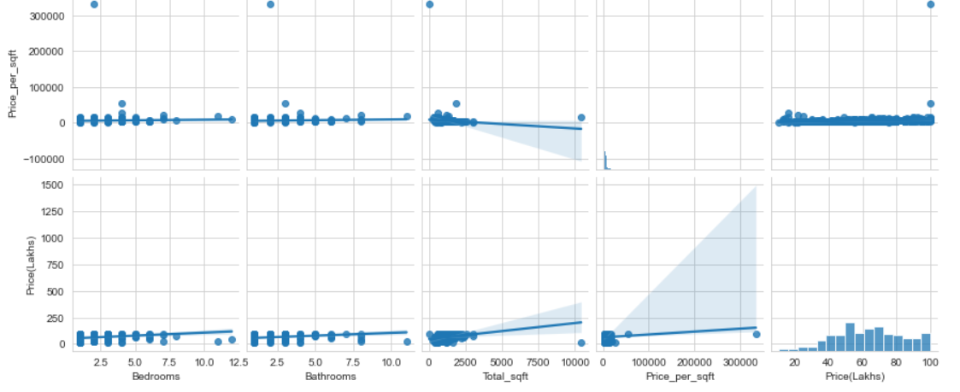
​
Pair plot between different attributes
For the price range of 100 to 900L,the relationship between each and every variable is plotted where the plots below the diagonal are having mirror plots above the diagonal.
There are positive and negative slopes above and below of the diagonal.

Slide 32
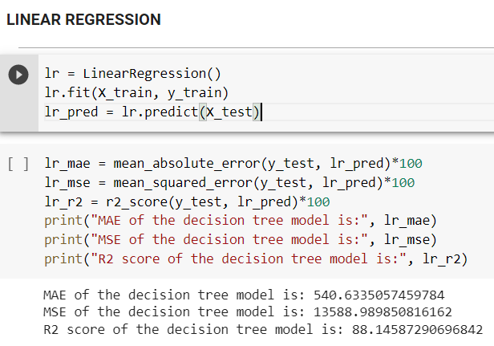
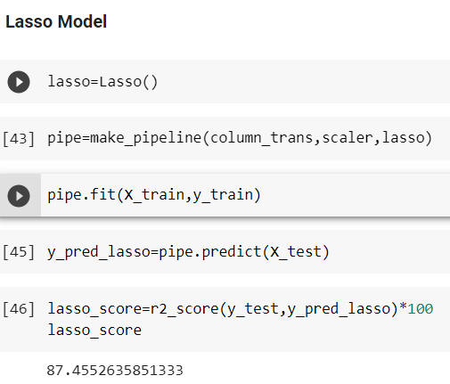
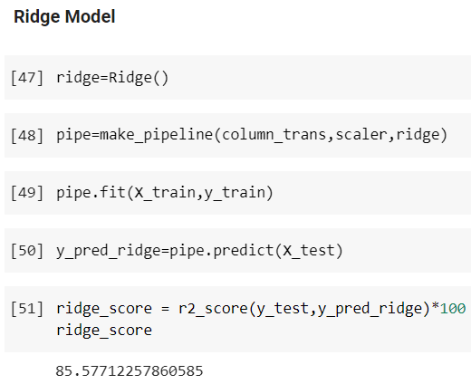
4. Data Modelling
Linear Regression Lasso Regression Ridge Regression

Slide 33


Decision Tree
Random Forest

Slide 34

The process of modelling means training a machine learning algorithm to predict the labels from the features.
We have used Random Forest algorithm for training and testing of the model.
The accuracy rate of our model is 91% which is pretty good

Slide 35
5. Deployment
Deployment using Streamlit :
Streamlit is a free and open-source framework to rapidly build and share beautiful machine learning and data science web apps. It is a Python-based library specifically designed for machine learning.

Slide 36



Slide 37

Exploratory Data Analysis

Slide 38


Slide 39





Slide 40


Slide 41



Slide 42



Slide 43
Challenges faced?
Data Collection
Time Consuming Implementation.
Inaccessible Data and Data Security.
Overfitting of training data.
Model Deployment.
How did we overcome?
To implement real case scenario, we collected data through web-scraping by using Selenium and Chrome-driver. To overcome from inadequate and overfitting of training data we removed unnecessary features, noise that affected the accuracy of result. As we increased model complexity, tried different actions for different results; hence editing of codes as well as resources. Thus, we deployed the model by using Streamlit.

Slide 44
6. Conclusion
With several characteristics, the suggested method predicts the property price in Bangalore. We experimented with different Machine Learning algorithms to get the best model. When compared to all other algorithms, the Random Forest Algorithm achieved the lowest loss and the greatest R-squared value. Streamlit was used to create the website.

Slide 45
Thank you!

